Slide 1

Control Systems (CS)
Lecture-2
Mathematical Modeling of Dynamic Systems
Note: I do not claim any originality in these lectures. The contents of this presentation are mostly taken from the book of Ogatta, Norman Nise, Bishop and B C. Kuo and various other internet sources.

Slide 2
Outline
Introduction
Types of Models
Mathematical Modeling of
Electrical Systems
Electronic Systems
Mechanical Systems
Electromechanical Systems

Slide 3
Types of Systems
Static System: If a system does not change with time, it is called a static system.
Dynamic System: If a system changes with time, it is called a dynamic system.

Slide 4
Dynamic Systems
A system is said to be dynamic if its current output may depend on the past history as well as the present values of the input variables.
Mathematically,
Example: A moving mass
y
u
Model: Force=Mass x Acceleration
M

Slide 5
Ways to Study a System
System
Experiment with actual System
Experiment with a model of the System
Physical Model
Mathematical Model
Analytical Solution
Simulation
Frequency Domain
Time Domain
Hybrid Domain

Slide 6
Model
A model is a simplified representation or abstraction of reality.
Reality is generally too complex to copy exactly.
Much of the complexity is actually irrelevant in problem solving.

Slide 7
What is Mathematical Model?
A set of mathematical equations (e.g., differential eqs.) that describes the input-output behavior of a system.
What is a model used for?
Simulation
Prediction/Forecasting
Prognostics/Diagnostics
Design/Performance Evaluation
Control System Design

Slide 8
Mathematical Model  Mathematical modeling of any control system is the first and foremost task that a control engineer has to accomplish for design and analysis of any control engineering problem.  A mathematical model of a dynamic system is defined as a set of differential equations that represents the dynamics of the system accurately, or at least fairly well.  Note that a mathematical model is not unique to a given system. A system may be represented in many different ways and, therefore, may have many mathematical models, depending on one’s perspective. For example, ▪ In optimal control problems, it is good to use state-space representations. ▪ On the other hand, for the transient-response or frequency-response analysis of singleinput-single-output, linear, time-invariant systems, the transfer function representation may be more convenient than any other.

Slide 9
❑ Once a mathematical model of a system is obtained, various analytical and computational techniques may be used for analysis and synthesis purposes. Because the systems under consideration are dynamic in nature, the equations are usually differential equations. If these equations can be linearized, then the Laplace transform may be utilized to simplify the method of solution. 3 Different Mathematical Models  Commonly used mathematical models are ▪ Differential equation model (Time Domain). ▪ Transfer function model (S-Domain). ▪ State space model (Time Domain).  Use of the models depends on the application. For example, to find the transient or steady state response of SISO (Single Input Single Output) LTI (Linear Time Invariant) system transfer function model is useful. On the other hand for optimal control application state space model is useful.

Slide 10
Black Box Model
When only input and output are known.
Internal dynamics are either too complex or unknown.
Easy to Model
Input
Output

Slide 11
Grey Box Model
When input and output and some information about the internal dynamics of the system is known.
Easier than white box Modelling.
u(t)
y(t)
y[u(t), t]

Slide 12
White Box Model
When input and output and internal dynamics of the system is known.
One should know have complete knowledge of the system to derive a white box model.
u(t)
y(t)

Slide 13
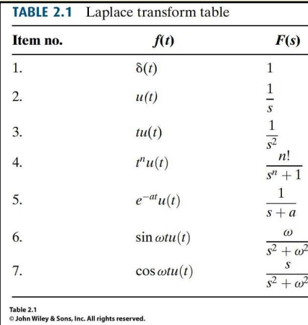
Laplace Transform
Laplace Transforms: method for
solving differential equations,
converts differential equations
in time 𝑡 into algebraic
equations in complex variable 𝑠.

Slide 14
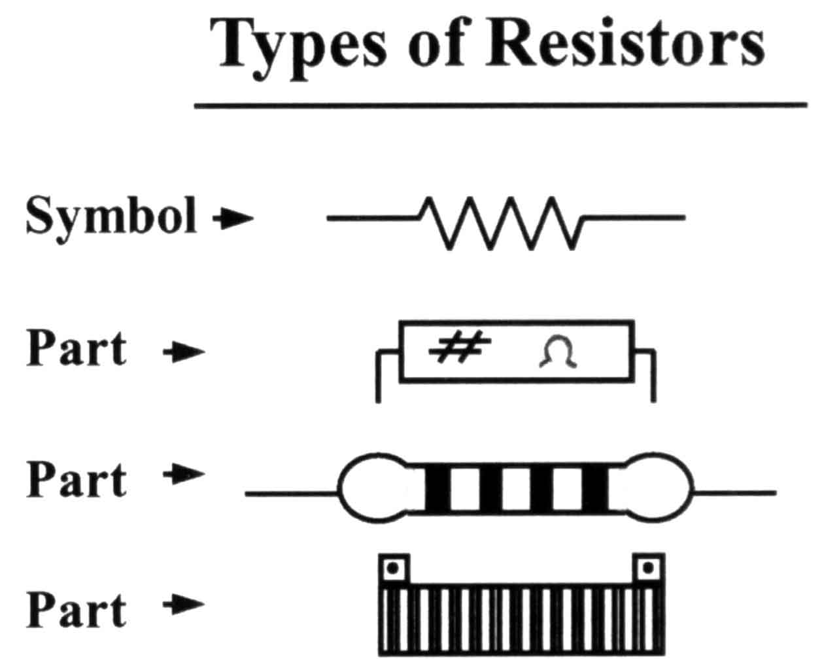


Basic Elements of Electrical Systems
Component | Symbol | V-I Relation (Time Domain) | V-I Relation (Frequency Domain)
Resistor
Capacitor
Inductor

Slide 15
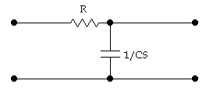
Example#1
The two-port network shown in the following figure has v_{i}(t) as the input voltage and v_{o}(t) as the output voltage. Find the transfer function V_{o}(s)/V_{i}(s) of the network.
v_{i}( t)
i(t)
C
v_{o}(t)

Slide 16
Example#1
Taking Laplace transform of both equations, considering initial conditions to zero.
Re-arrange both equations as:

Slide 17
Example#1
Substitute I(s) in equation on left

Slide 18
Example#1
The system has one pole at

Slide 19
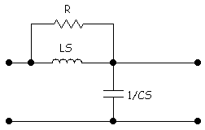
Example#2
Find the transfer function G(S) of the following two port network.
L
v_{i}(t)
i(t)
C
v_{o}(t)

Slide 20
Example#2
Simplify network by replacing multiple components with their equivalent transform impedance.
L
Z
V_{i}(s)
I(s)
C
V_{o}(s)

Slide 21
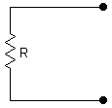
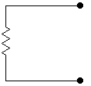
Transform Impedance (Resistor)
i_{R}(t)
I_{R}(S)
+
+
Transformation
v_{R}(t)
Z_{R} = R
V_{R}(S)
-
-

Slide 22
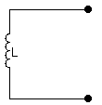
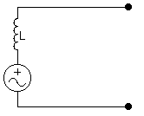
Transform Impedance (Inductor)
i_{L}(t)
I_{L}(S)
+
+
v_{L}(t)
Z_{L}=LS
V_{L}(S)
Li_{L}(0)
-
-

Slide 23
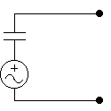
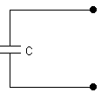
Transform Impedance (Capacitor)
i_{c}(t)
I_{c}(S)
+
+
v_{c}(t)
Z_{C}(S)=1/CS
V_{c}(S)
-
-

Slide 24
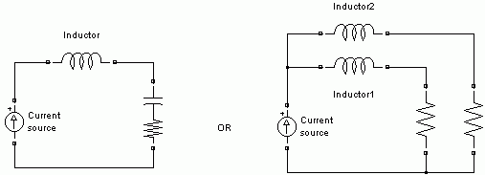
Equivalent Transform Impedance (Series)
Consider following arrangement, find out equivalent transform impedance.
L
C
R

Slide 25

Equivalent Transform Impedance (Parallel)
L
C
R

Slide 26
Equivalent Transform Impedance
Find out equivalent transform impedance of following arrangement.
L₂
L₂
R₁
R₂

Slide 27
Back to Example#2
L
Z
V_{i}(s)
I(s)
C
V_{o}(s)

Slide 28
Example#2
L
Z
V_{i}(s)
I(s)
C
V_{o}(s)

Slide 29
Modeling of Electronic Systems

Slide 30
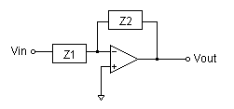
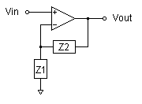
Operational Amplifiers

Slide 31
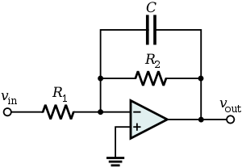
Example#3
Find out the transfer function of the following circuit.

Slide 32
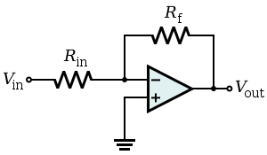
Example#4
Find out the transfer function of the following circuit.
v₁

Slide 33
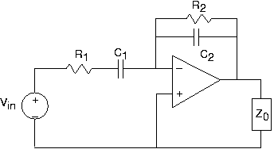
Example#5
Find out the transfer function of the following circuit.
v₁

Slide 34
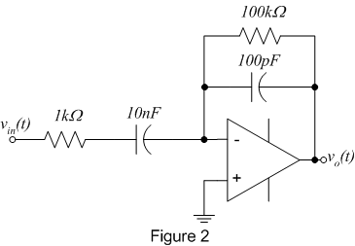
Example#6
Find out the transfer function of the following circuit and draw the pole zero map.
100kΩ
10kΩ

Slide 35
Modeling of Mechanical Systems
Part-I: Translational Mechanical System
Part-II: Rotational Mechanical System
Part-III: Mechanical Linkages

Slide 36
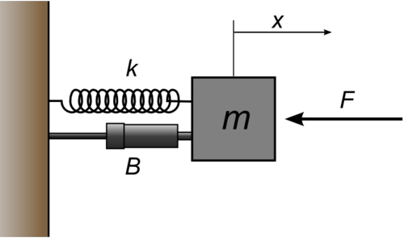
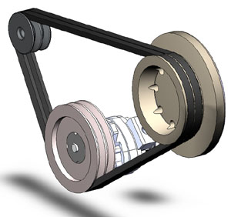
Basic Types of Mechanical Systems
Translational
Linear Motion
Rotational
Rotational Motion

Slide 37
Translational Mechanical Systems
Part-I

Slide 38


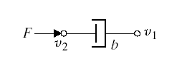
Basic Elements of Translational Mechanical Systems
Translational Spring
i)
Translational Mass
ii)
Translational Damper
iii)

Slide 39
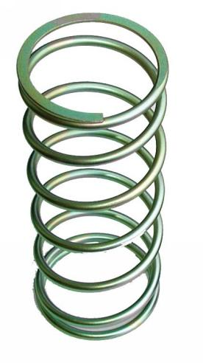

Translational Spring
A translational spring is a mechanical element that can be deformed by an external force such that the deformation is directly proportional to the force applied to it.
Translational Spring
i)
Circuit Symbols
Translational Spring

Slide 40
Translational Spring
If F is the applied force
Then is the deformation if
Or is the deformation.
The equation of motion is given as
Where is stiffness of spring expressed in N/m

Slide 41
Translational Mass
Translational Mass is an inertia element.
A mechanical system without mass does not exist.
If a force F is applied to a mass and it is displaced to x meters then the relation b/w force and displacements is given by Newton’s law.
Translational Mass
ii)
M

Slide 42
Translational Damper
When the viscosity or drag is not negligible in a system, we often model them with the damping force.
All the materials exhibit the property of damping to some extent.
If damping in the system is not enough then extra elements (e.g. Dashpot) are added to increase damping.
Translational Damper
iii)

Slide 43
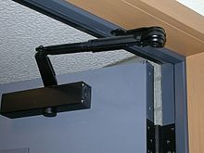
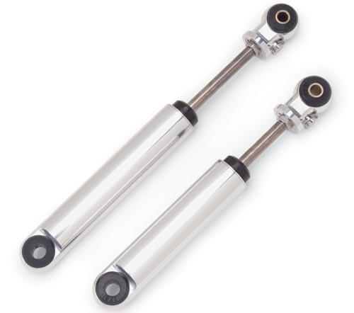
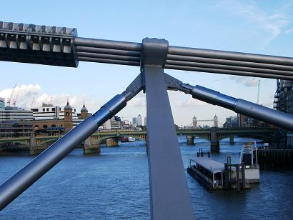
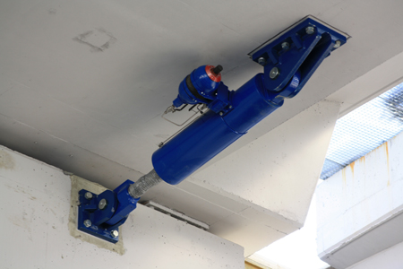
Common Uses of Dashpots
Door Stoppers
Vehicle Suspension
Bridge Suspension
Flyover Suspension

Slide 44

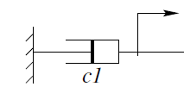

Translational Damper
Where C is damping coefficient (N/ms⁻¹).

Slide 45
Example-7
Consider the following system (friction is negligible)
Free Body Diagram
M
Where and are forces applied by the spring and inertial force respectively.

Slide 46
Example-7
M
Then the differential equation of the system is:
Taking the Laplace Transform of both sides and ignoring initial conditions we get

Slide 47
Example-7
The transfer function of the system is
if

Slide 48
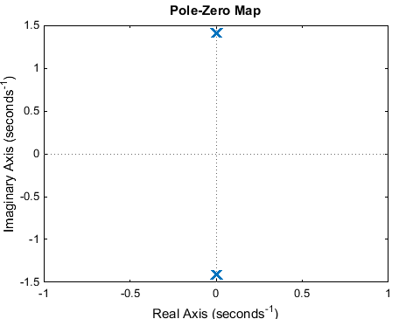
Example-7
The pole-zero map of the system is

Slide 49
Example-8
Consider the following system
Free Body Diagram
M

Slide 50
Example-8
Differential equation of the system is:
Taking the Laplace Transform of both sides and ignoring
Initial conditions we get

Slide 51
Example-8
if

Slide 52
Example-9
Consider the following system
Mechanical Network
↑
M

Slide 53
Example-9
Mechanical Network
↑
M
At node
At node

Slide 54
Example-10
↑
M₁
M₂

Slide 55
Rotational Mechanical Systems
Part-I

Slide 56

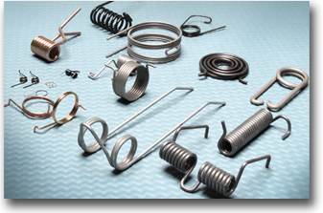
Basic Elements of Rotational Mechanical Systems
Rotational Spring

Slide 57
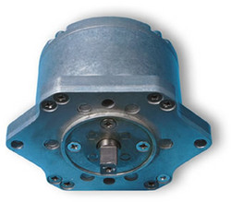
Basic Elements of Rotational Mechanical Systems
Rotational Damper

Slide 58
Basic Elements of Rotational Mechanical Systems
Moment of Inertia

Slide 59
Example-11
↑
J₁
J₂

Slide 60
Example-12
↑
J₁
J₂

Slide 61
Example-13

Slide 62
Mechanical Linkages
Part-III

Slide 63
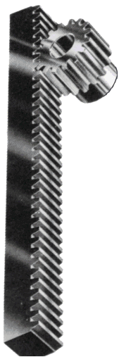
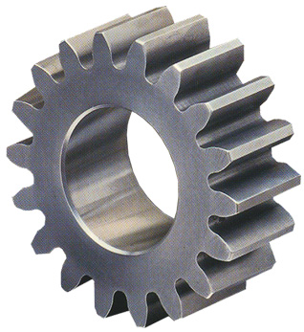
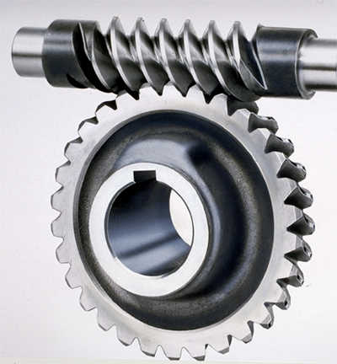
Gear
Gear is a toothed machine part, such as a wheel or cylinder, that meshes with another toothed part to transmit motion or to change speed or direction.

Slide 64
Fundamental Properties
The two gears turn in opposite directions: one clockwise and the other counterclockwise.
Two gears revolve at different speeds when number of teeth on each gear are different.

Slide 65
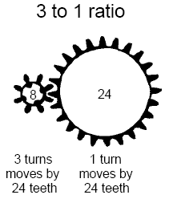
Gear Ratio
You can calculate the gear ratio by using the number of teeth of the driver divided by the number of teeth of the follower.
We gear up when we increase velocity and decrease torque.
Ratio: 3:1
We gear down when we increase torque and reduce velocity.
Ratio: 1:3
Driver
Follower
Gear Ratio = # teeth input gear / # teeth output gear
= torque in / torque out = speed out / speed in

Slide 66
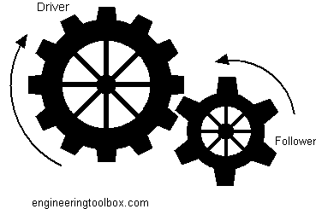
Mathematical Modeling of Gear Trains
Gears increase or reduce angular velocity (while simultaneously decreasing or increasing torque, such that energy is conserved).
Energy of Driving Gear = Energy of Following Gear
Number of Teeth of Driving Gear
Angular Movement of Driving Gear
Number of Teeth of Following Gear
Angular Movement of Following Gear

Slide 67
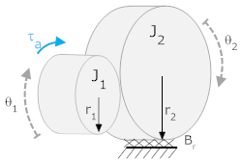
Mathematical Modeling of Gear Trains
In the system below, a torque, τ_{a}, is applied to gear 1 (with number of teeth N₁, moment of inertia J₁ and a rotational friction B₁).
It, in turn, is connected to gear 2 (with number of teeth N₂, moment of inertia J₂ and a rotational friction B₂).
The angle θ₁ is defined positive clockwise, θ₂ is defined positive clockwise. The torque acts in the direction of θ₁.
Assume that T_{L} is the load torque applied by the load connected to Gear-2.
N₂
N₁
B₁
B₂

Slide 68
Mathematical Modeling of Gear Trains
For Gear-1
For Gear-2
Since
therefore
Eq (1)
Eq (2)
N₂
N₁
B₁
B₂
Eq (3)

Slide 69
Mathematical Modeling of Gear Trains
Gear Ratio is calculated as
Put this value in eq (1)
Put T₂ from eq (2)
Substitute θ₂ from eq (3)
N₂
N₁
B₁
B₂

Slide 70
Mathematical Modeling of Gear Trains
After simplification

Slide 71
Mathematical Modeling of Gear Trains
For three gears connected together

Slide 72
Modeling of Electromechanical Systems

Slide 73
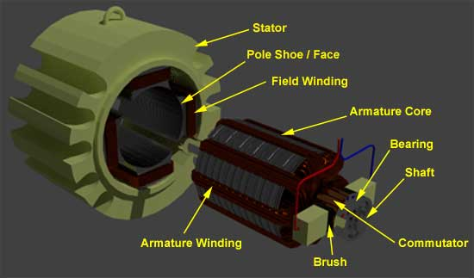
D.C Drives
Variable Voltage can be applied to the armature terminals of the DC motor .
Another method is to vary the flux per pole of the motor.
The first method involve adjusting the motor’s armature while the latter method involves adjusting the motor field. These methods are referred to as “armature control” and “field control.”

Slide 74
Example-14: Armature Controlled D.C Motor
R_{a}
L_{a}
Input: voltage u
Output: Angular velocity ω
B
i_{a}
u
e_{b}
T
J
ω
Electrical Subsystem (loop method):
V_{f}=constant
Mechanical Subsystem

Slide 75
Example-14: Armature Controlled D.C Motor
R_{a}
L_{a}
Power Transformation:
B
i_{a}
u
e_{b}
T
J
Torque-Current:
Voltage-Speed:
ω
V_{f}=constant
Combing previous equations results in the following mathematical model:

Slide 76
Example-14: Armature Controlled D.C Motor
Taking Laplace transform of the system’s differential equations with zero initial conditions gives:
Eliminating I_{a} yields the input-output transfer function

Slide 77
Reduced Order Model
Example-14: Armature Controlled D.C Motor
Assuming small inductance, L_{a} ≈0

Slide 78
Example-14: Armature Controlled D.C Motor
If output of the D.C motor is angular position θ then we know
R_{a}
L_{a}
B
i_{a}
u
e_{b}
T
J
θ
V_{f}=constant
Which yields following transfer function

Slide 79
Example-15: Field Controlled D.C Motor
R_{f}
R_{a}
L_{a}
i_{f}
e_{f}
L_{f}
T_{m}
J
e_{a}
B
ω
Applying KVL at field circuit
Mechanical Subsystem

Slide 80
Example-15: Field Controlled D.C Motor
Power Transformation:
Torque-Current:
where K_{f}: torque constant
Combing previous equations and taking Laplace transform (considering initial conditions to zero) results in the following mathematical model:

Slide 81
Example-15: Field Controlled D.C Motor
Eliminating I_{f}(S) yields
If angular position θ is output of the motor
R_{f}
R_{a}
L_{a}
i_{f}
e_{f}
L_{f}
T_{m}
J
e_{a}
B
θ

Slide 82



Example-16: Angular Position Control System
R_{a}
L_{a}
N₁
+
k_{p}
₋
J_{M} B_{M}
+
+
+
B_{L}
i_{a}
T
e
e_{a}
e_{b}
θ
J_{L}
r
c
_
_
_
N₂
i_{f} = Constant

Slide 83
Numerical Values for System constants
r = angular displacement of the reference input shaft
c = angular displacement of the output shaft
θ = angular displacement of the motor shaft
K₁ = gain of the potentiometer shaft = 24/π
K_{p} = amplifier gain = 10
e_{a} = armature voltage
e_{b} = back emf
R_{a} = armature winding resistance = 0.2 Ω
L_{a} = armature winding inductance = negligible
i_{a} = armature winding current
K_{b} = back emf constant = 5.5x10⁻² volt-sec/rad
K_{t} = motor torque constant = 6x10⁻⁵ N-m/ampere
J_{m} = moment of inertia of the motor = 1x10⁻⁵ kg-m²
B_{m}=viscous-friction coefficients of the motor = negligible
J_{L} = moment of inertia of the load = 4.4x10⁻³ kgm²
B_{L} = viscous friction coefficient of the load = 4x10⁻² N-m/rad/sec
n= gear ratio = N₁/N₂ = 1/10

Slide 84
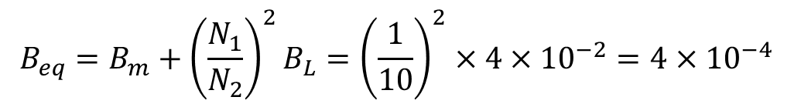
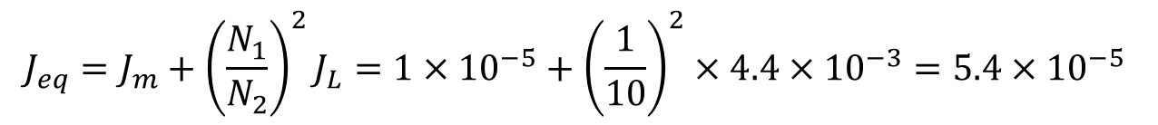
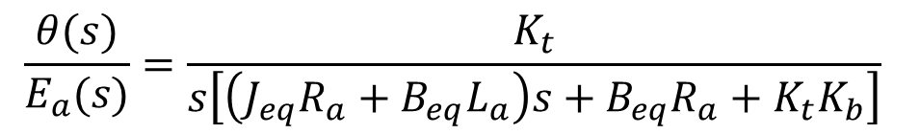
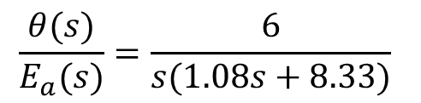
Example-16: Angular Position Control System
Transfer function of the armature controlled D.C motor with load connected to it is given by
Where
$$\frac{θ(s)}{E_{a}(s)}=\frac{K_{t}}{s\left[\left(J_{eq}R_{a}+B_{eq}L_{a}\right)s+B_{eq}R_{a}+K_{t}K_{b}\right]}$$
$$J_{eq}=J_{m}+{\left(\frac{N_{1}}{N_{2}}\right)}^{2}J_{L}=1×{10}^{−5}+{\left(\frac{1}{10}\right)}^{2}×4.4×{10}^{−3}=5.4×{10}^{−5}$$
$$B_{eq}=B_{m}+{\left(\frac{N_{1}}{N_{2}}\right)}^{2}B_{L}={\left(\frac{1}{10}\right)}^{2}×4×{10}^{−2}=4×{10}^{−4}$$
$$\frac{θ(s)}{E_{a}(s)}=\frac{6}{s(1.08s+8.33)}$$

Slide 85

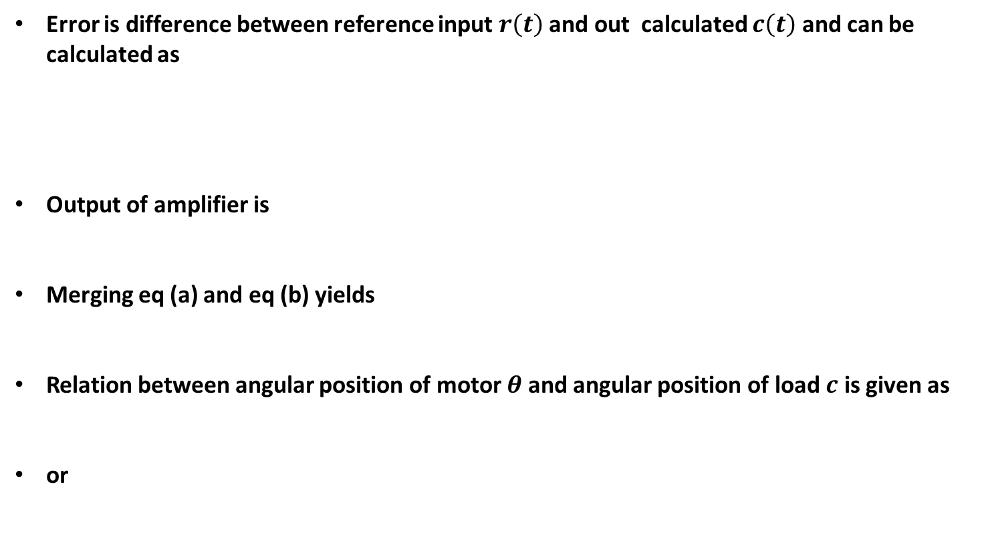
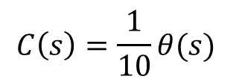




Example-16: Angular Position Control System
Error is difference between reference input $r\left(t\right)$ and out calculated $c\left(t\right)$ and can be calculated as
Output of amplifier is
Merging eq (a) and eq (b) yields
Relation between angular position of motor $θ$and angular position of load $c$ is given as
or
$$e\left(t\right)=K_{1}\left[r\left(t\right)−c(t)\right]$$
E$\left(s\right)=\frac{24}{π}\left[R\left(S\right)−C(S)\right]=7.64\left[R\left(S\right)−C(S)\right]$
(a)
$$E_{a}\left(s\right)=K_{p}E\left(s\right)=10E(s)$$
(b)
$E_{a}\left(s\right)=76.4$ $\left[R\left(S\right)−C(S)\right]$
$$C\left(s\right)=\frac{1}{10}θ(s)$$
$$10C\left(s\right)=θ(s)$$

Slide 86
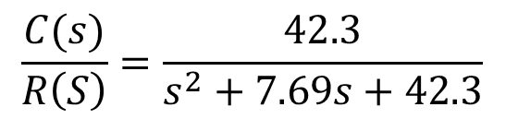
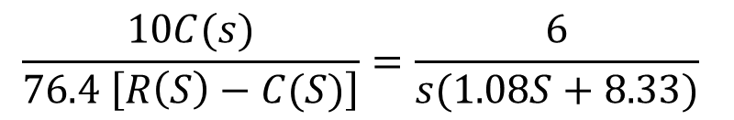
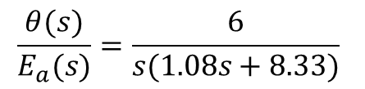
Example-16: Angular Position Control System
$$\frac{θ(s)}{E_{a}(s)}=\frac{6}{s(1.08s+8.33)}$$
Final Closed loop transfer function of the system can now be written as
$$\frac{10C(s)}{76.4 \left[R\left(S\right)−C(S)\right]}=\frac{6}{s(1.08S+8.33)}$$
$$\frac{C(s)}{R\left(S\right)}=\frac{42.3}{s^{2}+7.69s+42.3}$$

Slide 87
End of Lecture-2
To download this lecture visit
http://imtiazhussainkalwar.weebly.com/

